Slide 1
Introduction to Programming with the Arduino 2013
Notes:
1. Add photos of the circuits
2. Show more clearly how energy flows through breadboard
3. Explain connectivity and wires
4. Show the wiring of the breadboards
5. Parts, and wires need to share the same row
6. Explain the LED before wiring, do an LED to battery. Maybe, burn it out to show the problem of no resistor.
7. Explanation of polarity in regards to troubleshooting and debugging.
8. Show in diagrams the part in holes more clearly.

Slide 2
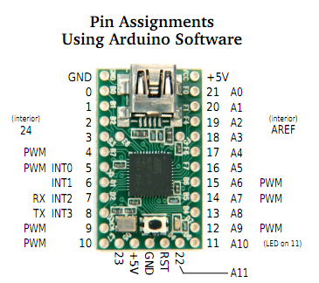
What Arduino are we using today?
Teensy 2.0 Arduino variation

Slide 3
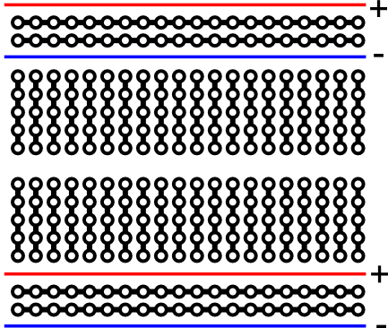
Breadboards

Slide 4
Exercise 1: Blink the LED
Blink 'Hello World' of microcontrollers.
It demonstrates digital output.
It also tells you that your device is working.
The Teensy has an on board LED on PIN 11.
We will configure the Arduino to blink an external LED on pin 11. So both blink at the same time.

Slide 5

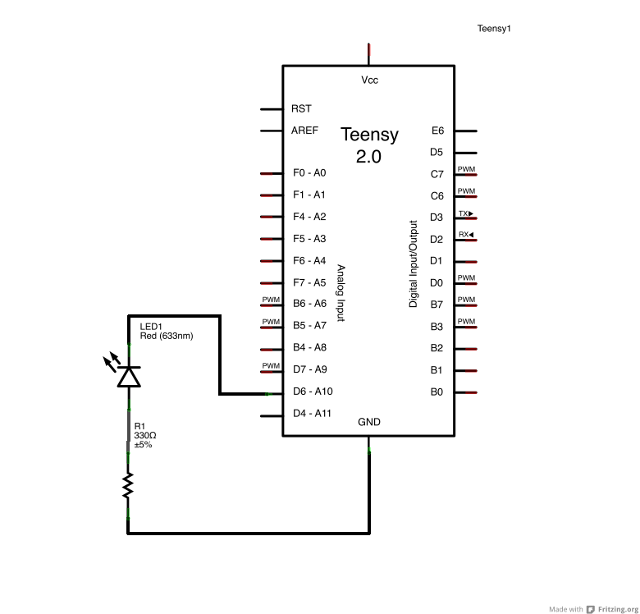

Slide 6
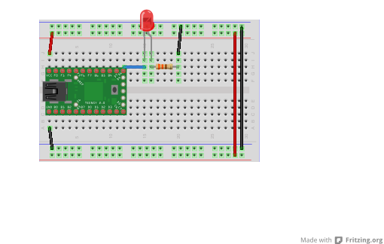
LED positive (long) leg connected to pin 11

Slide 7
Blink an LED
void setup() { //runs once } void loop() { //executed repeatedly }

Slide 8
Blink an LED
int ledPin = 11; //led on pin 11
//defined in one place for our convenience
void setup() { } void loop() { }

Slide 9
Blink an LED
int ledPin = 11; //led on pin 11 void setup() { pinMode(ledPin, OUTPUT); } void loop() { }

Slide 10
Blink an LED
int ledPin = 11; //led on pin 11 void setup() { pinMode(ledPin, OUTPUT); } void loop() { digitalWrite(ledPin, HIGH); }

Slide 11
Blink an LED
int ledPin = 11; //led on pin 11 void setup() { pinMode(ledPin, OUTPUT); } void loop() { digitalWrite(ledPin, HIGH); digitalWrite(ledPin, LOW); }

Slide 12
Blink an LED
Single line comment
Declaration of an integer
int ledPin = 11; //led on pin 11 void setup() { pinMode(ledPin, OUTPUT); } void loop() { digitalWrite(ledPin, HIGH); delay(1000); digitalWrite(ledPin, LOW); delay(1000); }
Declaration of a function with VOID return type
Calling a predefined function
Function arguments (constants)
Reserved words

Slide 13
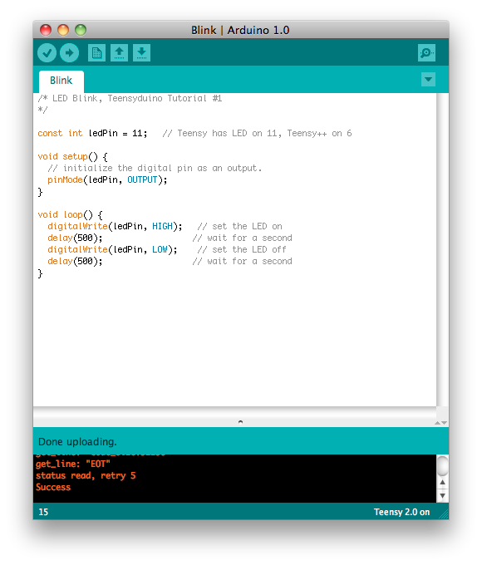
Blink an LED

Slide 14

Blink an LED
Verify = Compile and debug

Slide 15
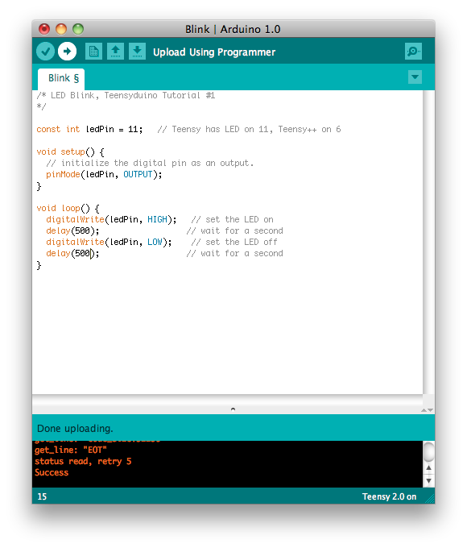
Blink an LED
Upload = Compile and Upload to the board

Slide 16
Other uses for digital output
Switching other devices on/off
Relays - Can open/close a switch in a separate circuit for controlling high-power loads and avoiding electrical noise
Transistors - Can be used to amplify a signal to much higher power than the microcontroller alone
Communication
Software Serial

Slide 17
Analog out with PWM
PWM - Stands for Pulse Width Modulation
So far we know how to turn an output OFF or ON (LOW and HIGH)
What if we want to change the speed of a motor, or the intensity of a light?
PWM output is a signal where the output switches very rapidly between fully on and fully off. For a lower value, the output is on a smaller percentage of the time, for a higher value, the output is on for a larger percentage of the time.

Slide 18
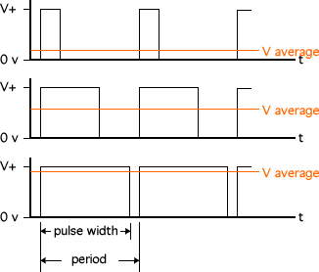
PWM

Slide 19
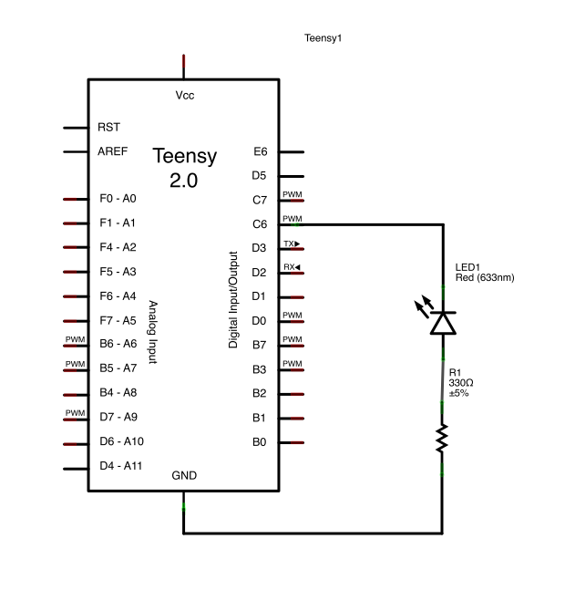
Exercise 3- Fade an LED on/off

Slide 20
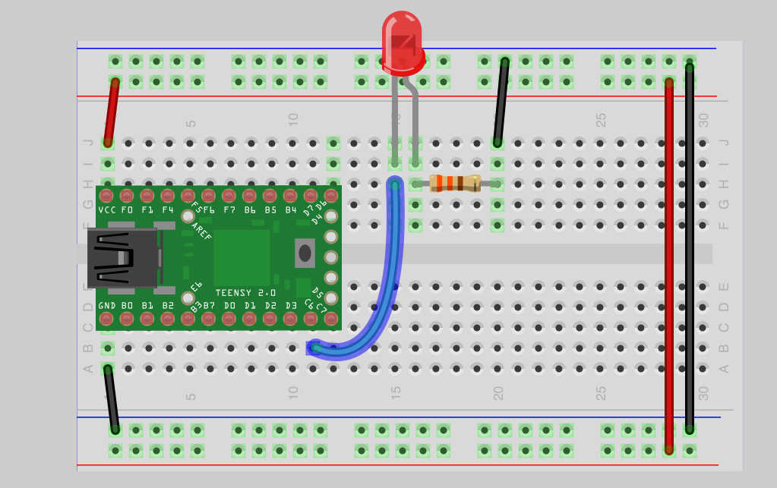
Exercise 3- Fade an LED on/off

Slide 21
Two ways to fade an LED
First way is to use void loop()
Increment and decrement the values every time through the loop. Same setup will be used in both examples:
/*==========================================================*/
const int ledPin = 9;
int brightness = 0; // how bright the LED is
int fadeAmount = 5; // how many points to fade the LED by
void setup() {
// declare pin 9 to be an output:
pinMode(ledPin, OUTPUT);
}

Slide 22
Fade inside loop()
const int ledPin = 9;
int brightness = 0; // how bright the LED is
int fadeAmount = 5; // how many points to fade the LED by
void setup() {
// declare pin 9 to be an output:
pinMode(ledPin, OUTPUT);
}
void loop() {
// set the brightness of pin 9:
analogWrite(ledPin, brightness);
// change the brightness for next time through the loop:
brightness = brightness + fadeAmount;
// reverse the direction of the fading at the ends of the fade:
if (brightness == 0 || brightness == 255) {
fadeAmount = -fadeAmount ;
}
// wait for 30 milliseconds to see the dimming effect
delay(30);
}

Slide 23
Fade an LED - using a for loop
Use the same setup code as before
Same circuit
You can use save as and delete the code in loop and replace with the new code

Slide 24
The for loop
for(int t=0; t<=100 ; t+=1) {
//Do something 100 times
}

Slide 25
Fade an LED - the Code
....
void loop()
{ for( )
{
// What goes in the for loop? // sets the value (range from 0 to 255. 8 bit resolution): analogWrite(ledPin, fadeValue); } }

Slide 26
Fade an LED - the Code
....
void loop()
{ for(int fadeValue = 0 ; fadeValue <= 255; fadeValue +=5)
{ // sets the value (range from 0 to 255): analogWrite(ledPin, fadeValue); } }

Slide 27
Fade an LED - the Code
....
void loop()
{ for(int fadeValue = 0 ; fadeValue <= 255; fadeValue +=5)
{ // sets the value (range from 0 to 255): analogWrite(ledPin, fadeValue); // wait for 30 milliseconds to see the dimming effect delay(30); } }

Slide 28
Fade an LED - the Code
....
void loop()
{ for(int fadeValue = 0 ; fadeValue <= 255; fadeValue +=5)
{ // sets the value (range from 0 to 255): analogWrite(ledPin, fadeValue); // wait for 30 milliseconds to see the dimming effect delay(30); }
// duplicate in reverse for(int fadeValue = 255 ; fadeValue >= 0; fadeValue -=5)
{ // sets the value (range from 0 to 255): analogWrite(ledPin, fadeValue); // wait for 30 milliseconds to see the dimming effect delay(30); } }

Slide 29
1 circuit -- 1,000 behaviors
With one simple circuit, you can write many behaviors just by changing the software, without having to alter the circuit or add additional components.

Slide 30
Digital vs Analog
What things are digital?
What things are analog?
What things appear to be digital or analog?
How can we communicate exact values?
How about approximate values?
What about minimum values?
What about maximum values?

Slide 31
Serial Output
Serial.begin(9600);
Starts the serial connection - call once at start of sketch Serial.println(someValue);
Sends someValue across the serial connection with a newline character.
var = Serial.read();
Returns incoming serial data, stores it in var

Slide 32
Exercise: Another Hello World
void setup()
{ Serial.begin(9600); } void loop()
{ Serial.println("Hello World");
delay(1000); }

Slide 33
Analog Input
val = analogRead(analogPin);
Reads voltage on analog input pins and translates to a numerical value.
Value is based on percentage of reference voltage (in this case 5v)
The reading has a 10 bit resolution (returns a value in the range 0-1023)

Slide 34
Analog Read code
int sensorPin = A0;
int sensorVal = 0; void setup() { Serial.begin(9600); // setup serial
pinMode(sensorPin, INPUT);
} void loop() { sensorVal = analogRead(sensorPin); // read the input pin Serial.println(sensorVal); // debug value }

Slide 35
Blink with out delay:
Let’s Rewrite blink with out delay.
What will we need?
A Fixed time stamp (What units?)
A reading of the current clock value
Something to track the current state
Some conditional expression that checks if the amount of time passed is more than the length of time we want the led to stay on/off
A refrence:
http://arduino.cc/en/Tutorial/BlinkWithoutDelay

Slide 36
Blink with out delay
const int ledPin = 11; int ledState = LOW; //LOW is a reserved word
long previousMillis = 0; // Which one is this? long interval = 1000;
void setup() { pinMode(ledPin, OUTPUT); //setup } void loop() { unsigned long currentMillis = millis(); if(currentMillis - previousMillis > interval) { previousMillis = currentMillis; // why is this here? if (ledState == LOW) ledState = HIGH; else ledState = LOW; digitalWrite(ledPin, ledState); } }

Slide 37
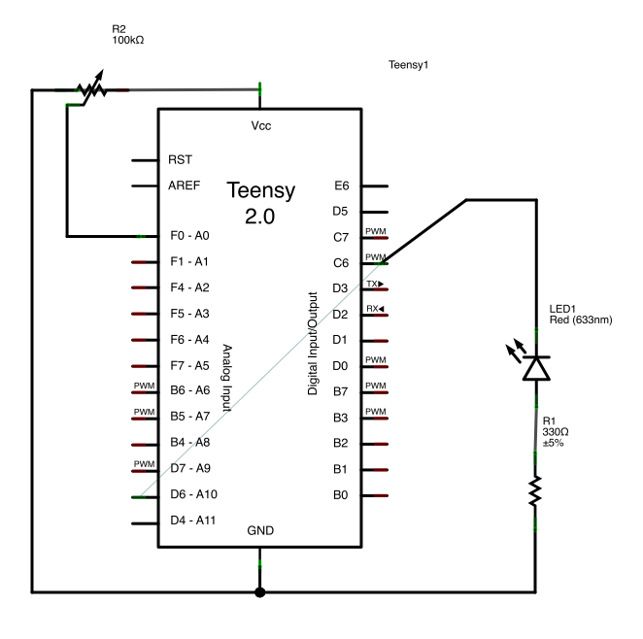
Exercise 5 - LED dimmer control
The circuit

Slide 38
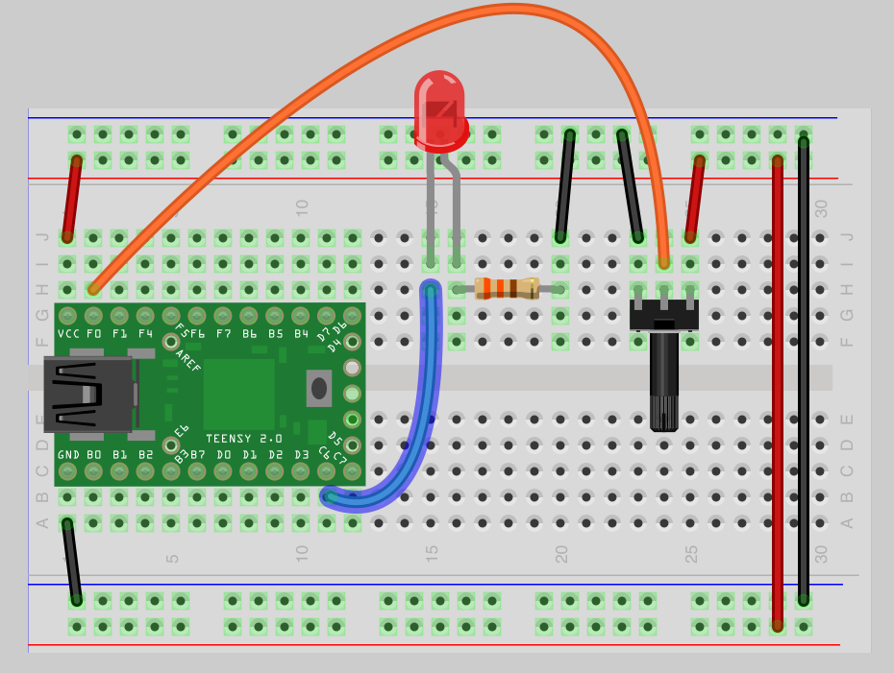
Starting Circuit

Slide 39
Dimmer Control code
int sensorPin = A0;
int ledPin = 9;
int sensorVal = 0; void setup() { Serial.begin(9600); // setup serial
pinMode(sensorPin, INPUT);
pinMode(ledPin, OUTPUT);
} void loop() { sensorVal = analogRead(sensorPin); // read the input pin Serial.println(sensorVal); // debug value
analogWrite(ledPin, sensorVal/4);}

